Slide 1


DR AMBEDKAR INSTITUTE OF TECHNOLOGY (An Autonomous Institute, Affiliated to Visvesvaraya Technological University, Belagavi, Accredited by NAAC, with 'A" Grade) Near Jnana Bharathi Campus, Bengaluru - 560056
DEPARTMENT OF COMPUTER SCIENCE & ENGINEERING
INTERNSHIP
“Front End Development”
Project topic : “ Portfolio Website”
Submitted by
Indu N 1DA20CS412
For the academic year
2022-2023
Dr. AIT, Bengaluru - 560056

Slide 2

PORTFOLIO WEBSITE
Investing with innovation

Slide 3
01
02
03
Table of contents
04
05
06
About company
Web development
IBM Edunet
Introduction to web development
Portfolio website
Design Website
About Portfolio website
Instruction to design a website
Key Elements
Output
Few Key Elements Portfolio Website
Outputs with the snapshots
07
Conclusion

Slide 4
ABOUT COMPANY
IBM means International Business Machines, one of the oldest and most reputed company in computer manufacturing. IBM was established in 1911 in New York and had been running since then. IBM provides various opportunities to individuals who have skills and are interested in working in their company.
Internship Program at IBM Landing an internship at IBM is a great way to start our career. For example, getting a web developer internship at IBM is a great opportunity and path to enter this field.

Slide 5
IBM Edunet AICTE
Below is the list of reasons to have an internship at IBM. Excellent working environment to build our career.
You can create an impact on society by building real-time projects.
Working at IBM will increase your innovative skill.
IBM provides flexible work hours.
IBM is a globally expanded company, so you will get the opportunity to build your network around the globe.
You can build a long-term career at IBM if selected as a full-time employee during your internship.

Slide 6
IBM Edunet
IBM provides various opportunities to individuals interested in working at IBM.
Consultant
Data Scientist
Designer
Developer
Finance
Human Resources
Technical Specialist
I have opted for Designer: The role of a designer is to provide interface design of a project or a model for the project.

Slide 7
Web Developmet
Web development, also known as web designing, refers to the tasks involved in creating and maintaining web pages and web applications that run online in a browser.
"Web development" usually refers to the main non-design aspects of building Web sites: writing markup and coding.
Web development may use content management systems (CMS) to make content changes easier and available with basic technical skills.
There are three kinds of Web developer specialization: front-end developer, back-end developer, and full-stack developer. Front-end developers are responsible for behaviour and visuals that run in the user browser, while back-end developers deal with the servers.
Front-end development refers to the practice of creating the user interface and user experience of a website or web application.

Slide 8
PORTFOLIO WEBSITE
A portfolio website is a digital platform that showcases your work, skills, and achievements. It serves as an online portfolio or resume, allowing you to present your talents and accomplishments to potential employers, clients, or collaborators.
A well-designed portfolio website can be a powerful tool for establishing your professional presence, attracting attention, and highlighting your unique abilities.
Overall, a portfolio website serves as a showcase of your skills, expertise, and accomplishments, allowing you to make a strong impression on potential clients or employers and help you stand out in a competitive professional landscape.

Slide 9
DESIGNING WEBSITE
Define your goals: Before you start designing your website, it's important to define your goals. Think about what you want to achieve with your website, who your target audience is, and what kind of impression you want to make.
Plan your content: Plan the content of your website, including the pages you'll need and the information you want to include on each page. This may include a homepage, about us page, products or services page, blog, and contact page.
Choose a platform: There are many platforms you can use to create a website. Consider the features and tools each platform offers and choose the one that best fits your needs.
Select a theme/template: Once you've chosen a platform, select a theme or template that fits your style and goals. Make sure the design is clean, professional, and easy to navigate.
Customize the design: Customize the design of your website to reflect your brand and style. This may include selecting a colour scheme, adding images and graphics, and choosing fonts.

Slide 10
Create content: Create high-quality content that is informative, engaging, and optimized for search engines. This may include text, images, videos, and more.
Optimize for search engines: To ensure your website can be found by potential visitors, optimize it for search engines by including relevant keywords, meta tags, and descriptions.
Make it responsive: With so many people accessing websites from mobile devices, it's important to ensure your website is responsive and looks good on all screen sizes.
Test and refine: Once you've designed your website, test it on different devices and browsers to ensure it works well and looks good. Refine the design and content as needed based on feedback from others.
Launch: When you're ready, launch your website and promote it on your social media channels, through email marketing, and other channels. Be sure to update it regularly with new content and keep it fresh and up-to-date.

Slide 11
KEY ELEMENTS IN PORTFOLIO WEBSITE
Home Page: This is the landing page of the website and should grab visitors' attention immediately. It often includes a brief introduction, a summary of your skills or expertise, and a visually appealing showcase of your work.
About Me: This section provides a more detailed description of who you are, your background, and your professional journey. It can include your education, relevant work experience, and any notable achievements or awards.
Services: If you offer specific services or expertise, this section outlines what you can provide to potential clients or employers. Describe your skills, areas of specialization, and any unique offerings you bring to the table.
Portfolio: The heart of your website, this section features examples of your work. It can include images, videos, links to projects, case studies, or descriptions of your contributions to specific endeavors. Organize your portfolio in a visually pleasing and easy-to-navigate manner.
Contact: Make it easy for visitors to get in touch with you. Provide a contact form, email address, or links to your social media profiles. Consider adding a call-to-action that encourages visitors to reach out for inquiries, collaborations, or employment opportunities.

Slide 12
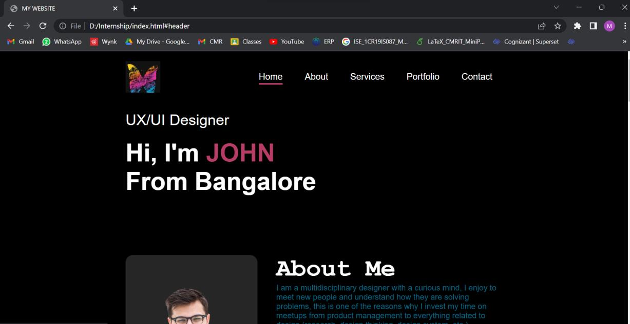
OUTPUT
Home Page
Place a prominent header at the top of the page, which typically includes your name or logo. This helps visitors easily identify your personal brand

Slide 13
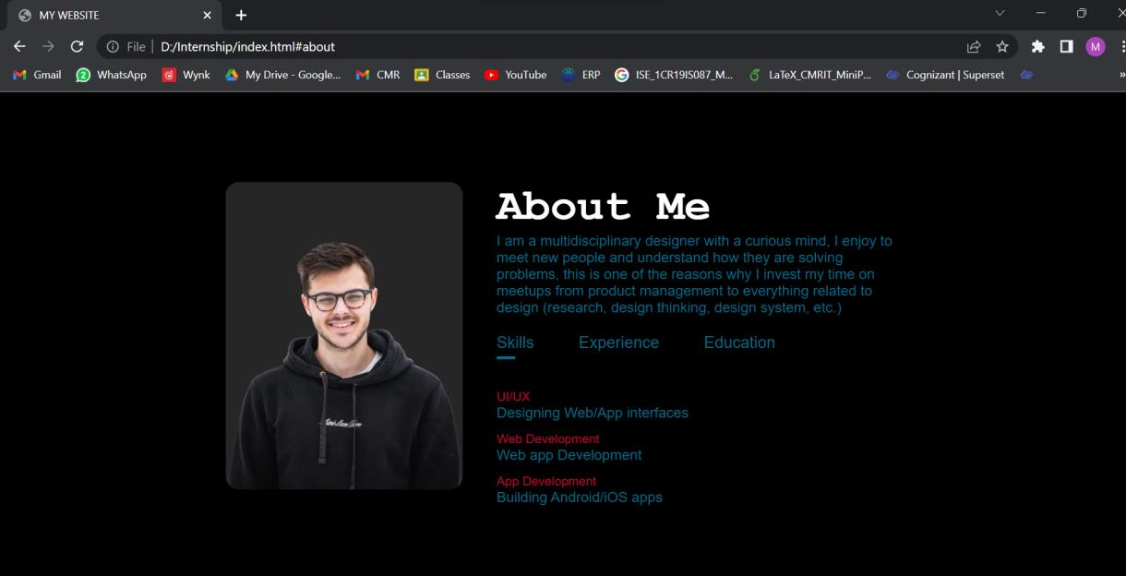
About Me
Write a brief and engaging introduction that describes who you are, what you do, and your unique selling points. Highlight your expertise and what sets you apart from others in your field.

Slide 14
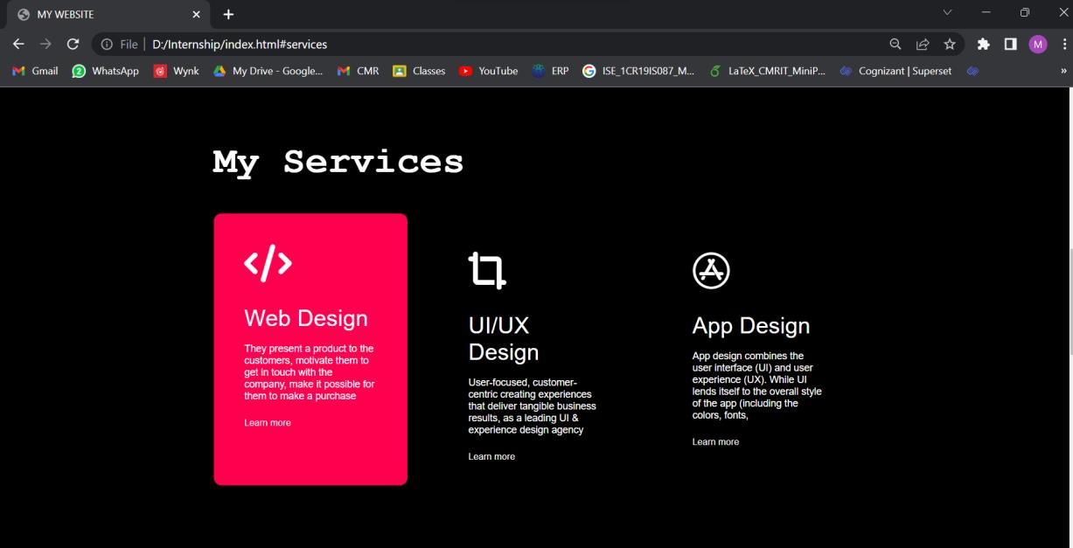
Services
Describe your skills, areas of specialization, and any unique offerings you bring to the table

Slide 15

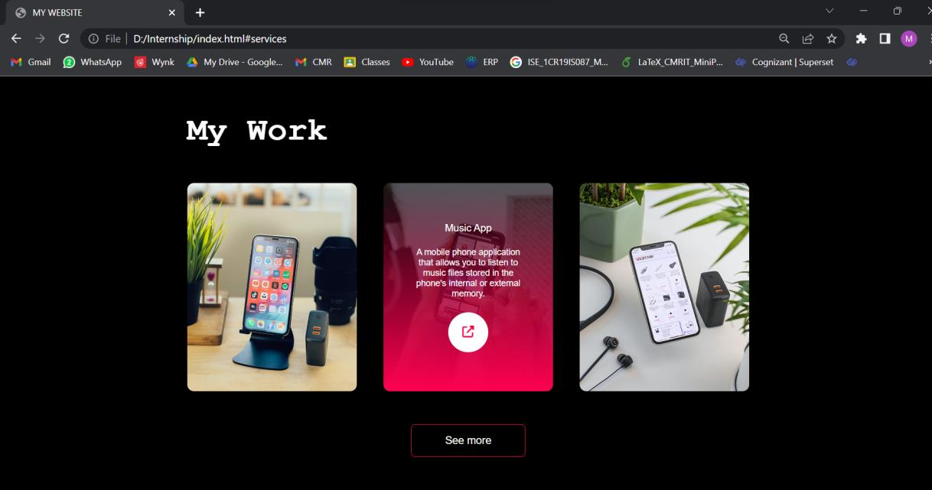
My Work Describe the project works in details

Slide 16
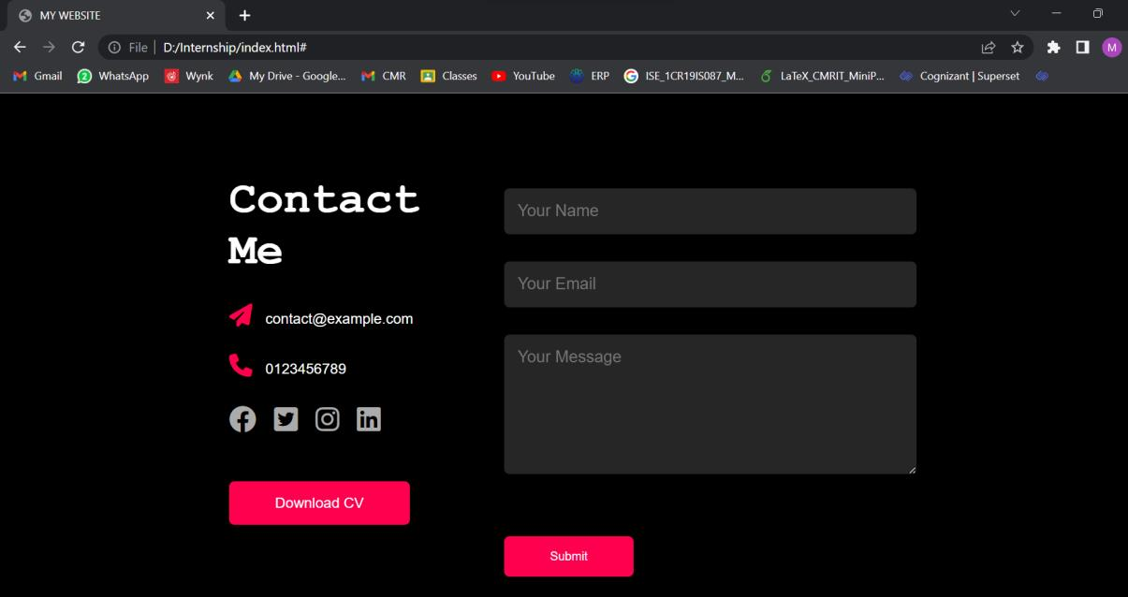
Contact Me
Provide a contact form, email address, or links to your social media profiles. Consider adding a call-to-action that encourages visitors to reach out for inquiries, collaborations, or employment opportunities.

Slide 17
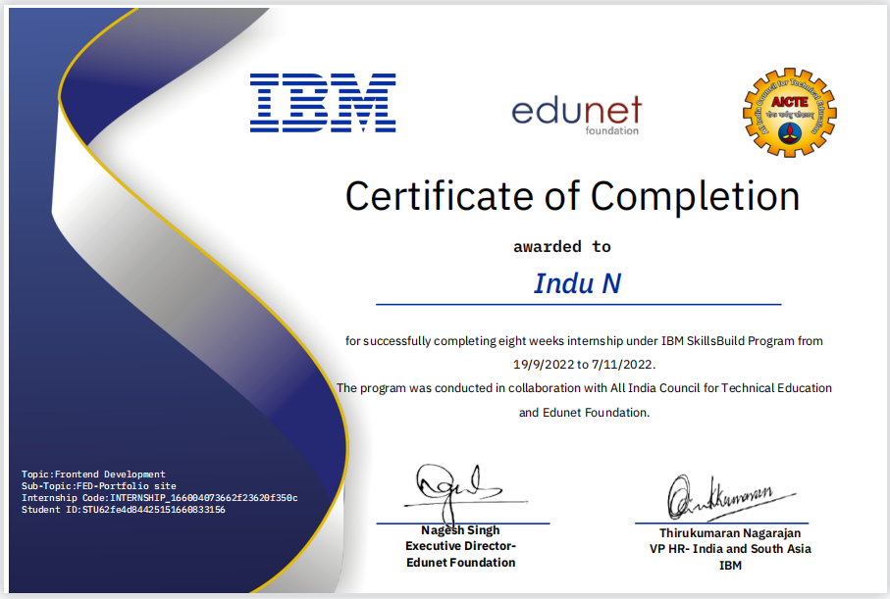
CERTIFICATE

Slide 18
CONCLUSION
A portfolio website is like a powerful online business card. It introduces you, shares your background and skills, and showcases your work. It's a way to impress potential clients or employers and make it easy for them to contact you. Having a well-designed portfolio website is crucial for anyone looking to succeed in their field and make a strong online presence.

Slide 19
Thank you...

